Slide 1
Envisionment
楊馥名 曾偉德 賴琮運 陳譽升

Slide 2
Envisionment
Externalization of ideas
Manipulability
Communication
Forms and representations
Notes:
See from other people’s perspectives, facilitate others seeing from yours
Shared exploration of design ideas

Slide 3
How to start exploring design ideas
Doing
Feeling
Knowing
Notes:
Doing: taking action on the world
Feeling: the opposite: how we perceive and make sense of the things in the world
Knowing: how we think (learning - novice stage of using interface and making sense of it/ planning - making interface fulfill the needs of expert: support advanced needs)

Slide 4

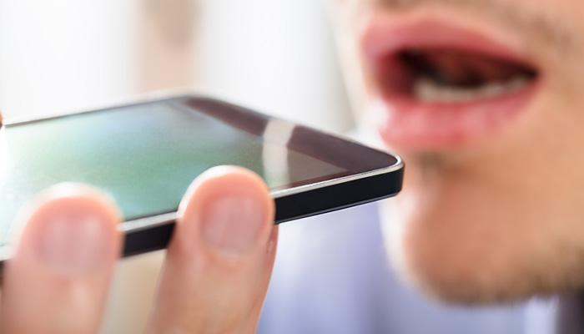
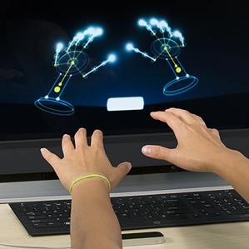
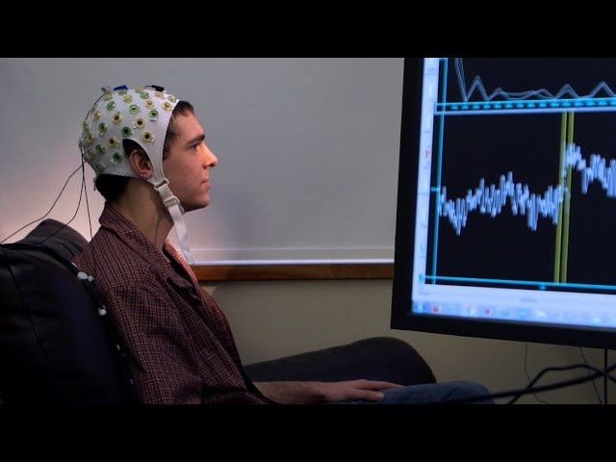
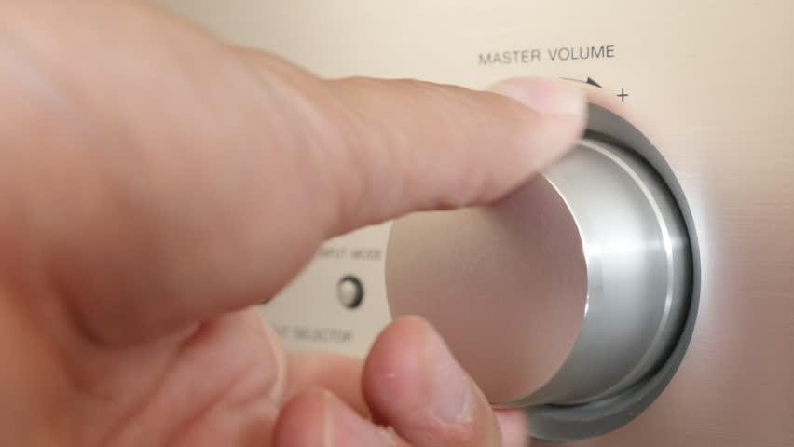
Doing
(Action)
Notes:
Simple: buttons, dials (flexibility)
Voice interfaces - telling siri what to do, talking on the phone
Motion tracking
Thinking-based (no physical action): Brain-computer interfaces (BCI)

Slide 5
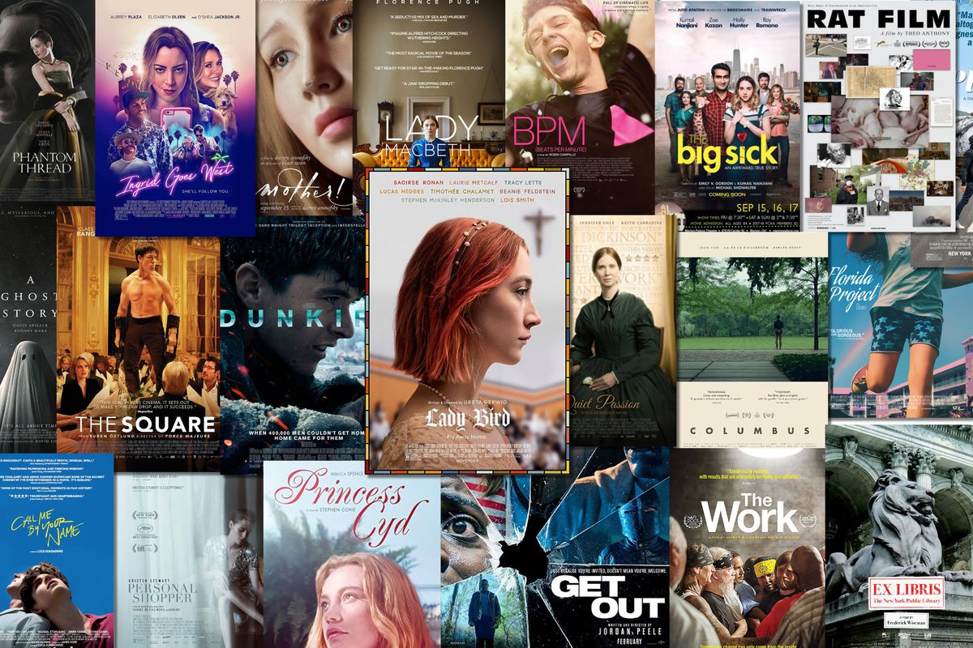

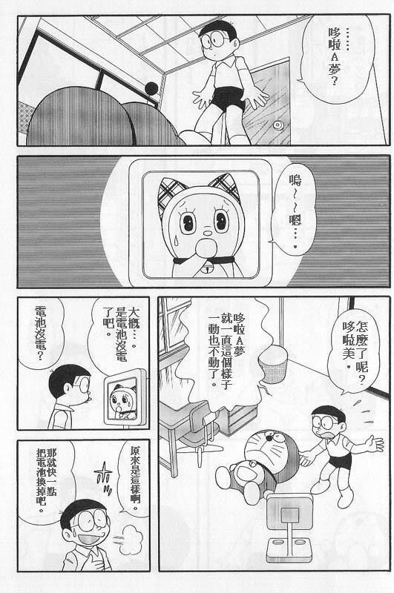



Feeling
Hot media → high-fidelity
Cool media → low-definition
Notes:
Cool media forces people to perceive sensory “gaps” in the content, high participation

Slide 6
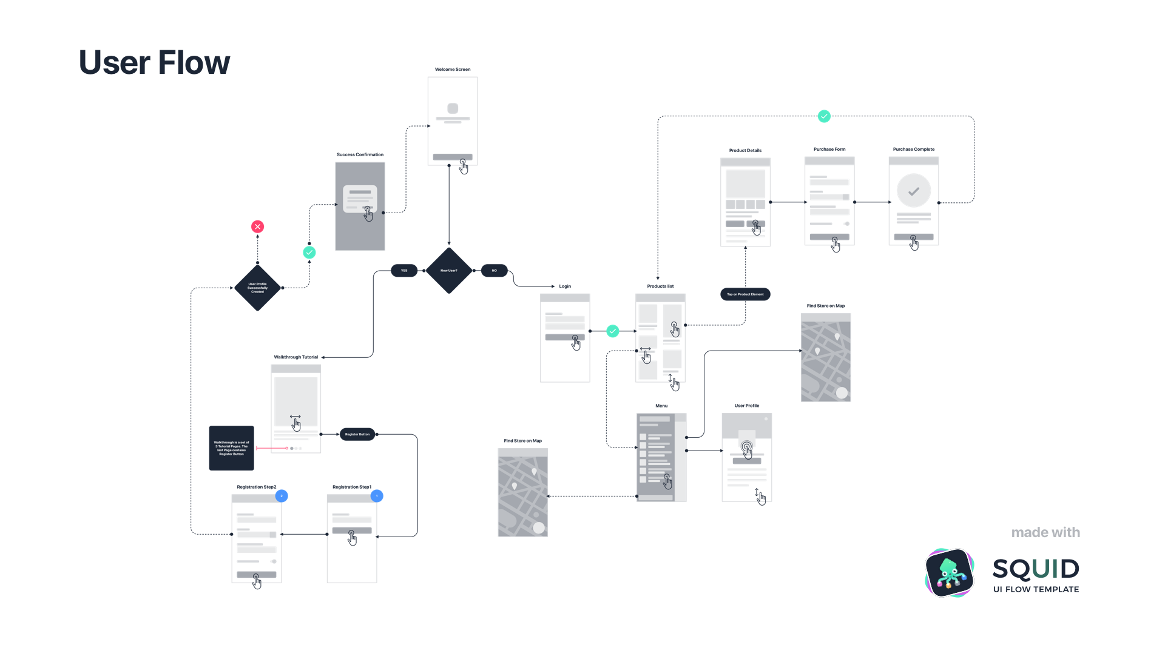
Knowing
Knowledge mapping = learning + planning
map
Uber’s interface flow chart
path
Notes:
Knowing involves learning, and planning
Paths are good for beginners just tell me step by step what to do.
Maps are good for understanding alternatives they take longer to learn but are more robust.
Flexibility, more information
Good for expert skill, more choices
Paths are good for expert skill; they can be very efficient.

Slide 7




Metaphors in design exploration
Paths and maps
Finding other creative and meaningful ways to represent an interaction
Navigation metaphors → “landscape”
Notes:
Path vs. map: opportunities for exploration
Drawing a connection between what we know in the real world and a design idea in the making
Wilderness: draws you in, lots of different feelings, attractive but scary and intimidating at the same time
(perhaps some type of game that does not give you a clear picture on purpose, an exploration or horror game)
Desert: no landmarks but gives you a deep impression
Open sea: a lot of information hidden under the surface, but have to dig (access to Web via Google Search)
Night sky: very little types of objects, about identifying, putting things together, working with patterns

Slide 8
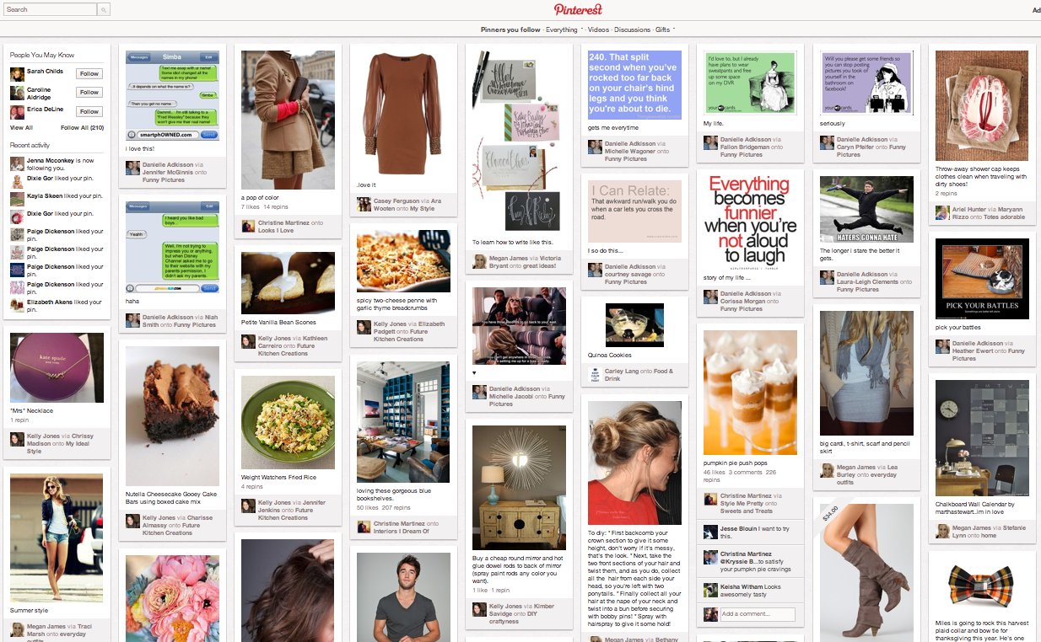
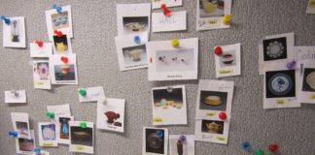
Metaphors in design exploration (cont.)
Pinterest

Slide 9
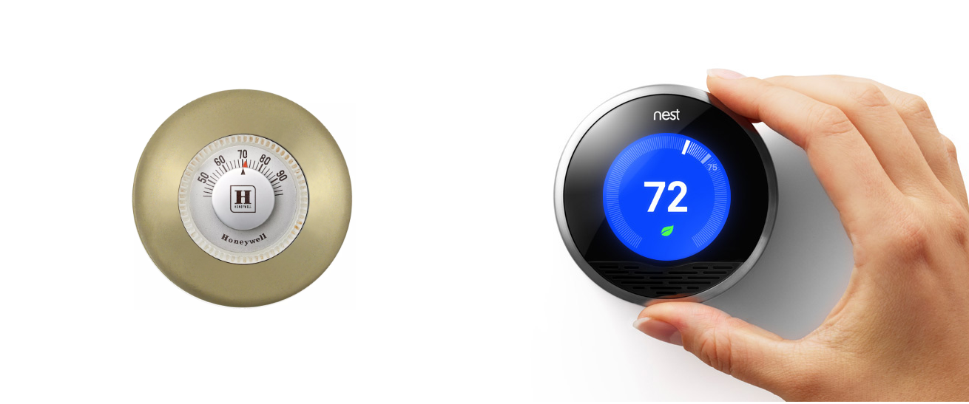
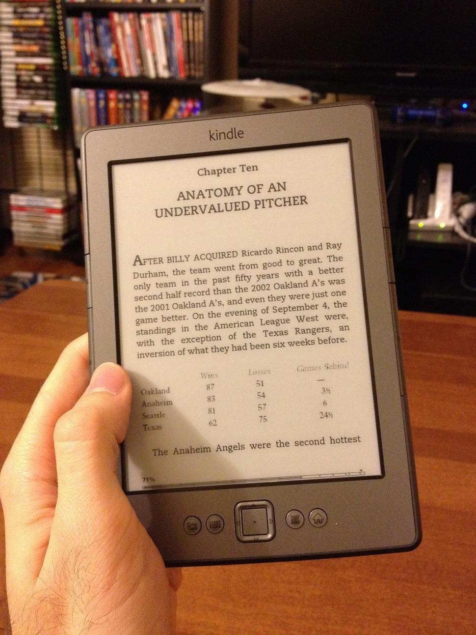
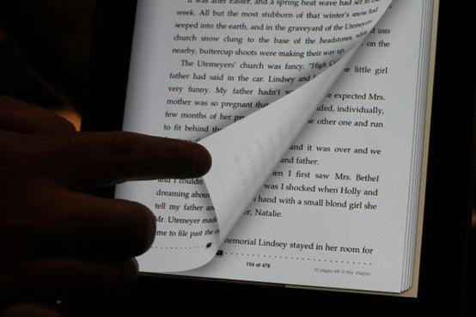
Metaphors in design exploration (cont.)
Kindle digital reader
Nest thermostat

Slide 10
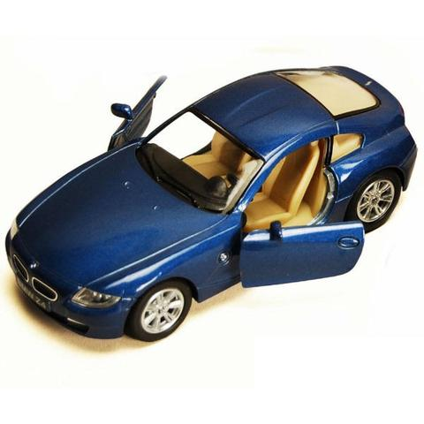
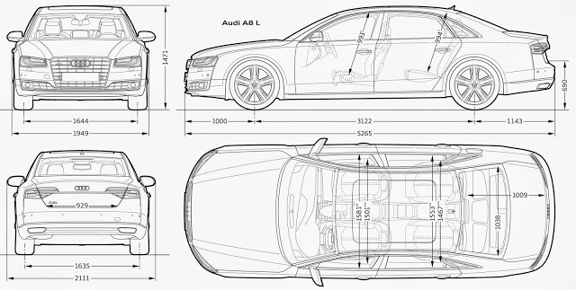
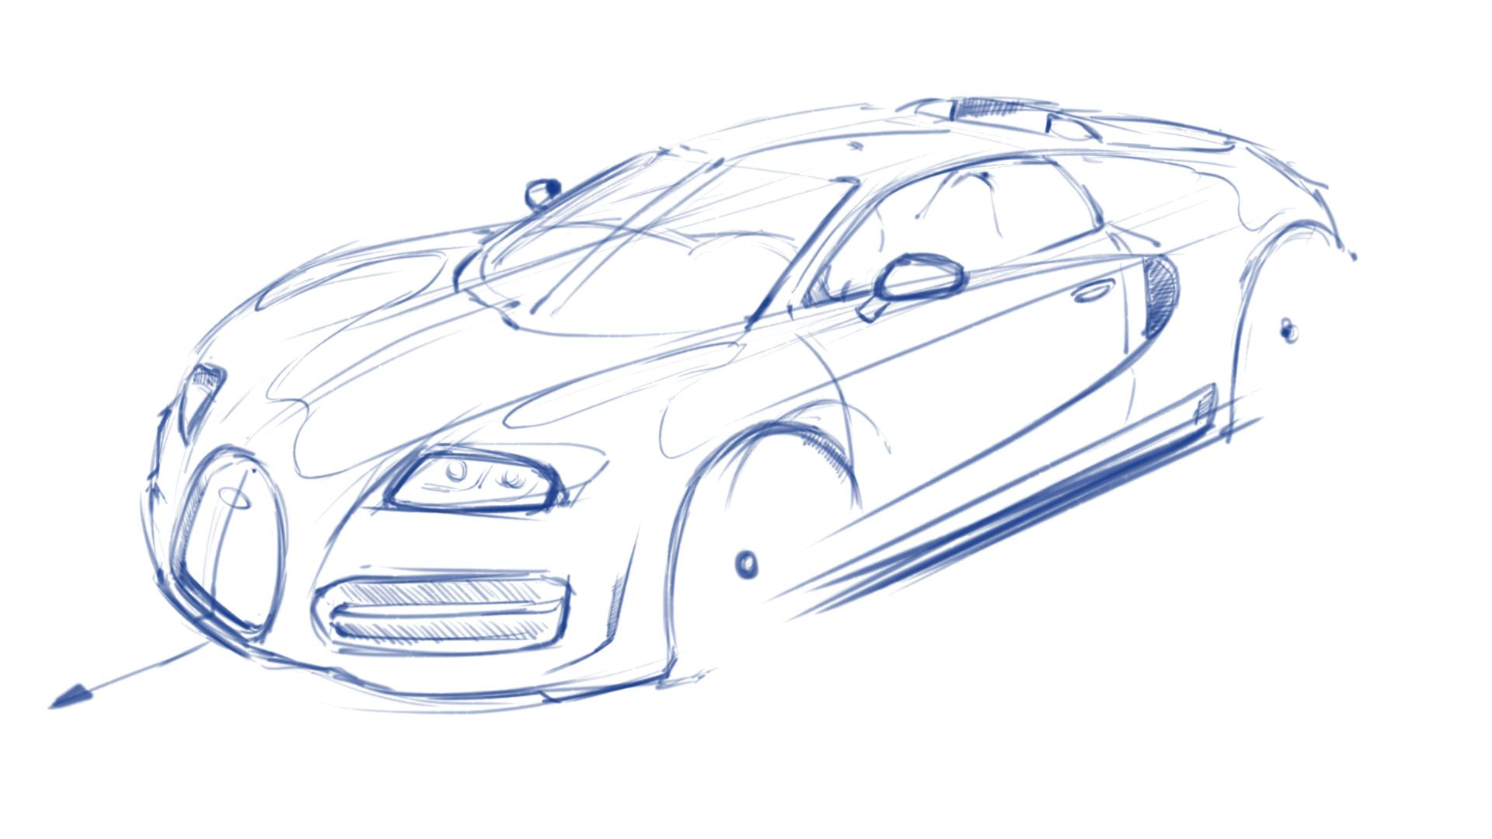
Choosing the best fit representation
Suitability depends on the stage in time and the person
Case: Car design
doodles
blueprints
scale model
Notes:
Working style, project type, available resources
Doodles - (cold) for other designers: generate creativity, ideas, questions,
Blueprints - (hot) clear representation for model maker as specs to make the model
Scale model - (hot) clear representation to sales (dfferent people) for customer reaction

Slide 11

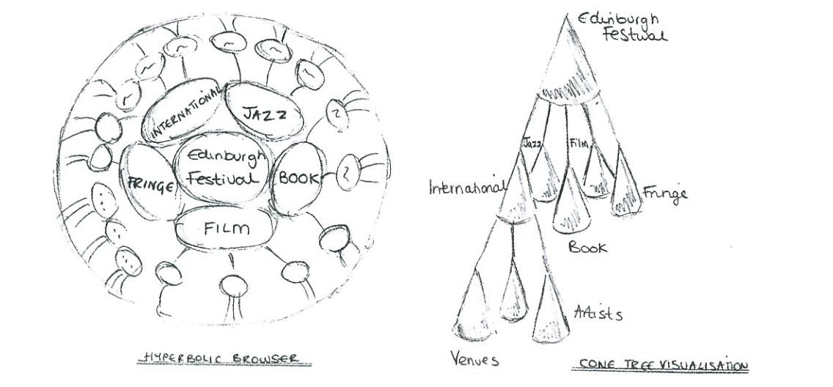
Sketches & Snapshots
最原始、初步的詮釋
捕捉轉瞬即逝的想法
視覺化產品的互動當下
單張的關鍵分鏡
比較各個想法之間的差異
The visualizations of
Edinburgh Festival scenario
Notes:
Envisionment的五種工具
一個畫的、一個更常使用軟體做出
右上角是意圖
舉出例子

Slide 12
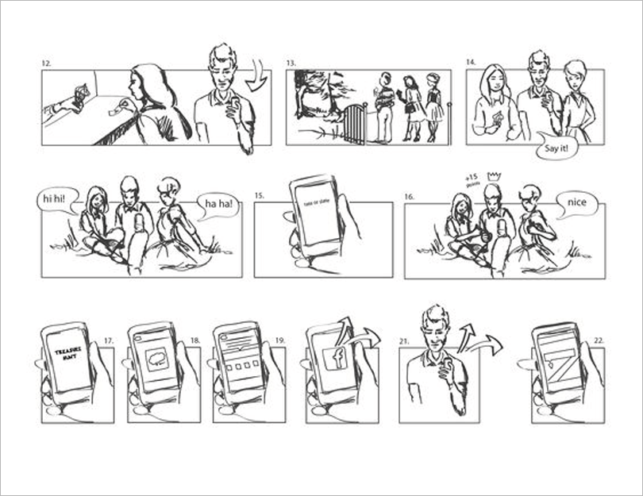
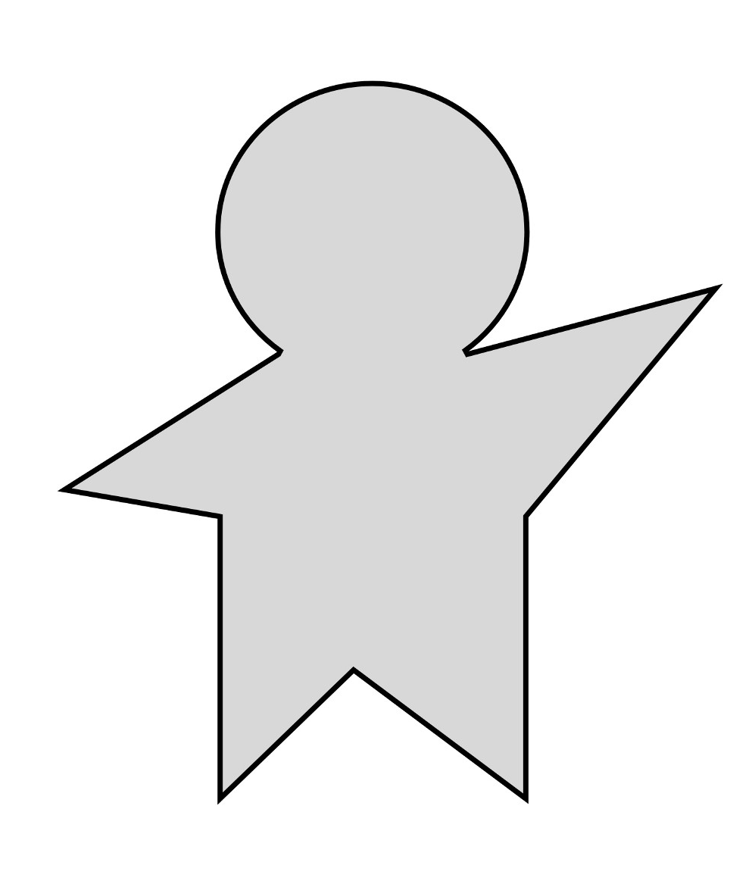
Storyboards
not about creating pretty pictures,
but about communicating ideas.
把體驗的過程視覺化
基於一個實際的情境
通常著重在展現意象而非美感
Notes:
定義
The key messages

Slide 13
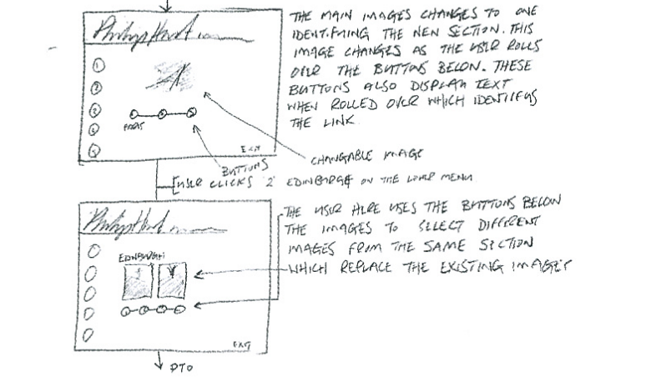
Storyboards
Traditional
使用者成功轉發地理位置！
期待大家到他指定的位置逕行尋寶。
附註文字，描寫當下場景和臆測使用者操作方式和心境。幫助其他人更快感受到動態的情境。
Scored
產品使用時隱含許多動態操作、顏色、樣式的改變，通常會使用符號進行註解。
Text-only
產品使用時隱含許多複雜的次序關係等，通常也會需要直接利用文字進行更為明白的註解。
Notes:
樣
scored ones例子：最右上角那張
我們挑的案例剛好沒有側邊加註文字 傳統型的會有 像最後一張那

Slide 14
Storyboards
I .
事先定義出使用者的操作步驟。
II .
Some
Key
Tips
首先決定視覺化第一張和最後一張故事板。
III .
先別急著添加額外的功能。
IV .
圍繞在現實生活可及的場景。
V .
盡可能凸顯設計者希望使用者會產生的情感。
VI .
專注在故事所要傳達的價值而非拘泥細節。
VII .
過程和結局是符合實際狀況的。
Notes:
https://uxplanet.org/ux-storyboarding-hacks-f4c32d7af920
2. 4 5.

Slide 15


Mood Boards
“ Anything goes to make sure that
everyone’s on the same page. “
色票、照片、圖案
雜誌、詩詞、字體
等。
提供並刺激靈感。
形容詞、風格
自由、不拘束的形式
Notes:
讓設計團隊都知道我們統一風格

Slide 16
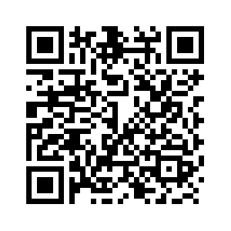
Activity Time !
假設
你要設計一個幫助頂客家庭
（就是雙薪無子）環遊世界
的旅遊網站，
請做出一個屬於你們風格的 MOOD BOARD！
https://goo.gl/CJfQXN

Slide 17
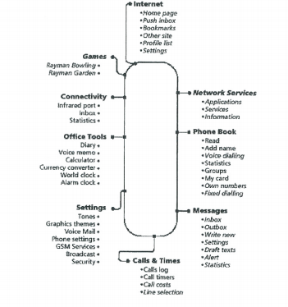
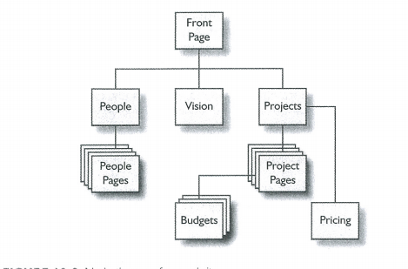
Navigation Maps
how the users move through
the sits or application.
設計使用者的使用流程
將所有流程列出並標記重點
目錄索引的概念，與情境配合

Slide 18
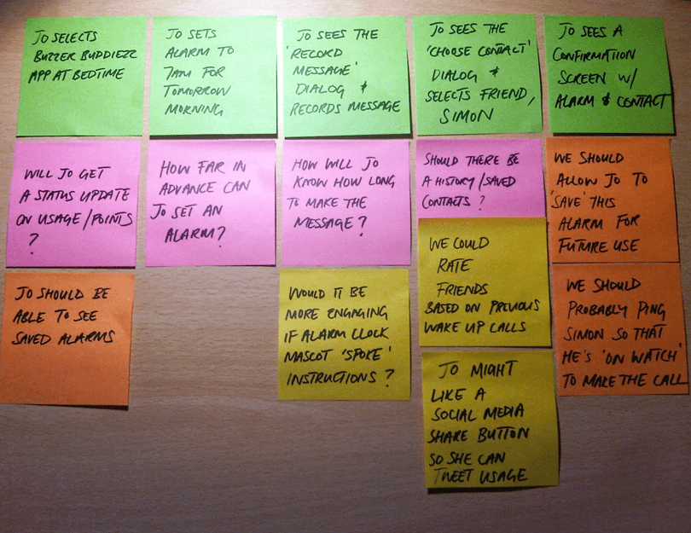
Scenarios
“Scenarios are the engine we use to
drive our designs.”
捕獲用戶執行任務方式的狀況
描繪現場動機並提出實行方法
描述使用者在給定的功能及路徑下所採用任務流
Scenarios help stakeholders envision
the ideas of the design team
by providing context
to the intended user experience

Slide 19

Exploring the design space
Notes:
Help analysis of the current situation

Slide 20
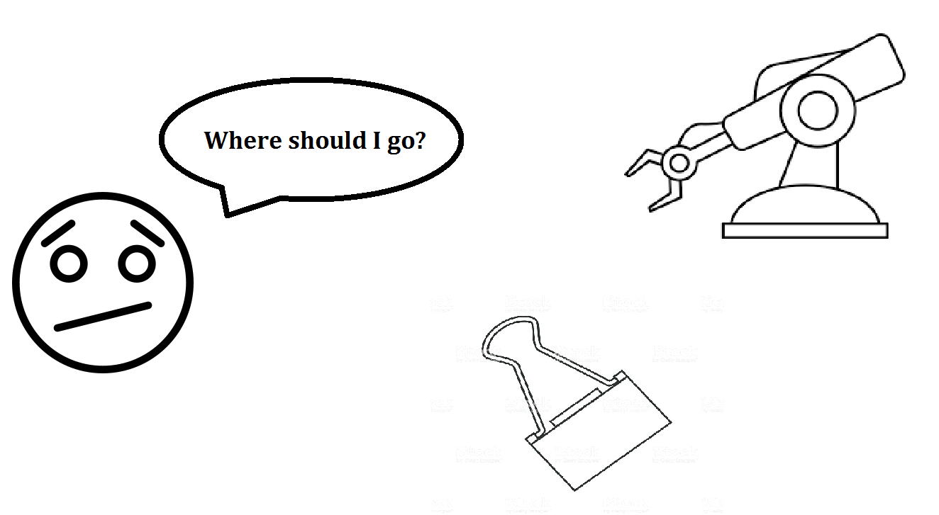
It might be necessary to revisit the requirements.

Slide 21
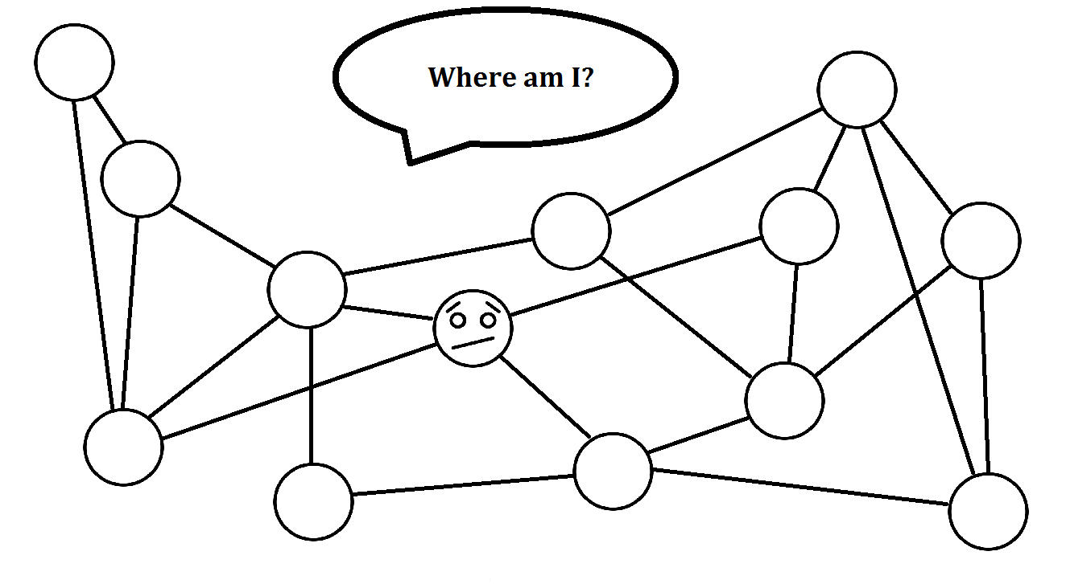
Analysis the current situation

Slide 22

We can only comment on concrete representation.

Slide 23

Focus on design issues.

Slide 24
John Carroll: trade-off to consider
design feature may lead to both positive and negative outcomes
Read article only
Read and write articles
Positive
Easier to implement.
Students will have less burden.
The assignment seems to be more realistic.
Negative
Has less sense of accomplishment.
More students may give up this homework.

Slide 25
An outline envisionment process
1.Review requirements and conceptual scenarios
2a.Develop representations of your design ideas
2b.New product: try different metaphors and design concept through representation
2c.Intended users should be involved as much as possible throughout wherever is possible.
Notes:
2a.Develop representations of your design ideas
minimum: include concrete scenarios,
storyboards developing the main interaction sequences
and snapshot sketches of 'key screens' or other aspects

Slide 26
3.Explore and document design decisions using a method such as claims analysis or QOC
4.Reconsider requirements and carry out where gaps have been uncovered

Slide 27
Summary
Appropriate representation for different context
Many possible envisionment techniques
Not to sit staring at a blank paper
Envisionment aids the generation, communication, evaluation
Notes:
get inspiration form any where
and externalizing ideas through envisionment
is the first step of design

